Slide 1
Lecture 4 Ordered Data and Data Quality
Vaibhav Chunekar
2/08/2023

Slide 2
Last Lecture Revision
Data:
Attributes of Data-Qualitative(Categorical)and Quantitative(Numeric)
Datasets- Dimensionality-curse of dimensionality-sparsity , resolution
Types of data sets-Record Data(Transaction ,document, sparse,Matrix)
Graph based data-WWW and molecular data

Slide 3
Ordered Data
For some types of data, the attributes have relationships that involve order in time or space. This data can be segregated into four types:
Sequential Data
Sequence Data
Time Series Data
Spatial Data

Slide 4
Sequential Data(Sequential Transaction Data)
Also referred to as temporal data.
It can be thought of as an extension of record data,
where each record has a time associated with it.
Example :
Consider a retail transaction data set that also stores the time at which the transaction took place

Slide 5
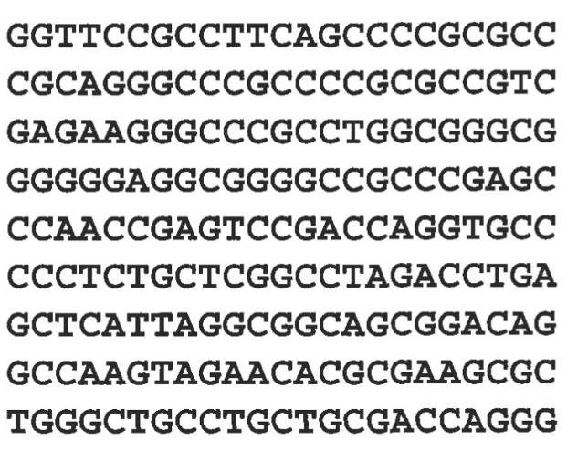
Sequence Data(e.g. Genomic Sequence data)
Sequence data consists of a data set that is a sequence of individual entities, such as a sequence of words or letters.
It is quite similar to sequential data, except that there are no time stamps; instead, there are positions in an ordered sequence.
For example, the genetic information of plants and animals can be represented in the form of sequences of nucleotides that are known as genes.

Slide 6
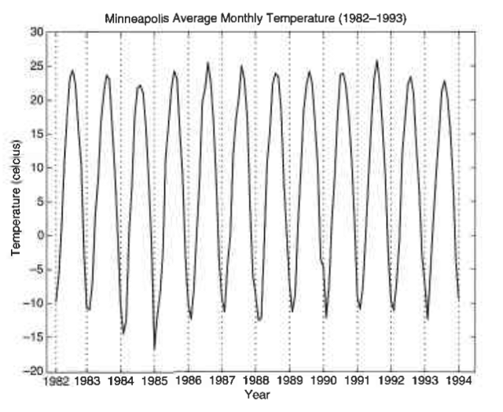
Time Series Data
Its a special type of sequential data .
Record is a time series, i.e., a series of measurements taken over time.
For example: a financial data set might contain objects that are time series of the daily prices of various stocks.

Slide 7
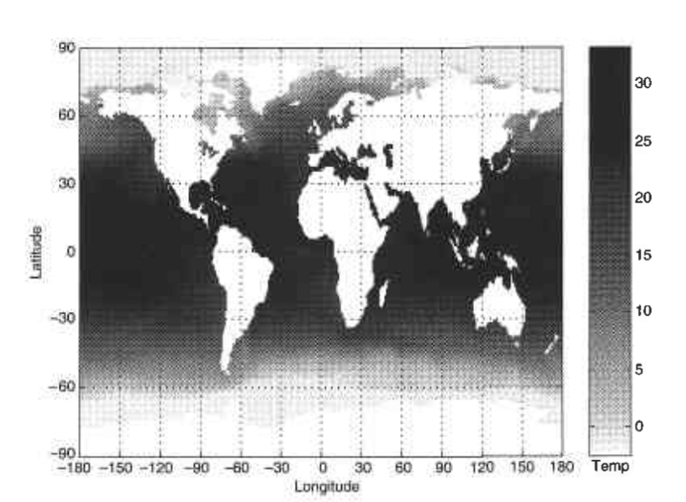
Spatial Data
Some objects have spatial attributes, such as positions or areas, as well as other types of attributes.
An example of spatial data is weather data (precipitation, temperature, pressure) that is collected for a variety of geographical locations.

Slide 8
Non Record Based Data
Example Benzene Ring-Substructure of atoms/molecules
Not Capture all the information in the data
Such data –data matrix where rows-locations and columns time

Slide 9
Data Quality
It refers to the ability of a data set to serve whichever need a company hopes to use it for.
That need
could be sending marketing materials to customers.
could be studying the market to plan a new product feature.
Could be maintaining a database of customer data for help with product support services
Could any number of other goals.
No matter what the exact use case for your data, data quality is important.
Without it, the data can’t fulfill its intended purpose.
Errors within a database of addresses would prevent you from using the data to reach customers effectively.
A database of phone numbers that doesn’t always include area codes for each entry falls short of providing the information you need to put the data to use in many situations.

Slide 10
Common causes of data quality problems
Manual Entry
OCR errors
Lack of complete information
Ambiguous data
Duplicate data
Data transformation errors

Slide 11
Common Errors
1. Manual data entry errors
Humans are prone to making errors, and even a small data set that includes data entered manually by humans is likely to contain mistakes. Data entry errors such as typos, data entered in the wrong field, missed entries, and so on are virtually inevitable.
2. OCR errors
Machines can make mistakes when entering data, too. In cases where organizations must digitize large amounts of data quickly, they often rely on Optical Character Recognition, or OCR, technology to do so. OCR technology scans images and extracts text from them automatically. It can be very useful when, for example, you want to take thousands of addresses that are printed on paper and enter them into a digital database so you can analyze them. The problem with OCR is that it is almost always imperfect.
If you’re OCR’ing thousands of lines of text, you’re almost certainly going to have some characters or words that are misinterpreted – zeroes that are interpreted as eights, for example, or proper nouns that are read as common words because the OCR tool fails to distinguish properly between capital and lowercase letters. The same sorts of issues arise with other types of automated machine entry of data, such as text-to-speech

Slide 12
Common Errors
3. Lack of complete information
When compiling a data set, you frequently run into the problem of not having all information available for every entry.
For example, a database of addresses may be missing the zip codes for some entries because the zip codes couldn’t be determined via the method that was used to compile the dataset.
4. Ambiguous data
When building a database, you may find that some of your data is ambiguous, leading to uncertainty about whether, how and where to enter it.
For example, if you are creating a database of phone numbers, some of the numbers you seek to enter may be longer than the typical ten digits that you have in a United States phone number. Are those longer numbers simply typos, or are they international phone numbers that include more digits? In the latter case, does the number contain complete international dialing information?
These are the sorts of questions that are hard to answer quickly and systematically when you’re working with a large body of data.

Slide 13
Common Error
5. Duplicate data
You may find that two or more data entries are mostly or completely identical.
For example, maybe your database contains two entries for a John Smith living at 123 Main St. Based on this information, it’s difficult to know whether these entries are simply duplicates (maybe John Smith’s information was entered twice by mistake) or if there are two John Smiths (a father and son, perhaps) living at the same address. You need to sort out seemingly duplicate entries like this to make the best use of your data.
6. Data transformation errors
Converting data from one format to another can lead to mistakes.
As a simple example, you may have a spreadsheet that you convert to a comma-separated value, or CSV file. Because data fields inside CSV files are separated by commas, you may run into issues when performing this conversion in the event that some of the data entries in your spreadsheet contain commas inside them.
Unless your data conversion tools are sufficiently smart, they won’t know the difference between a comma that is supposed to separate two data fields and one that is an internal part of a data entry. This is a basic example; things get much more complicated when you must perform complex data conversions, such as taking a mainframe database that was designed decades ago and converting it to NoSQL, a category of database that has become popular in just the last few years.

Slide 14
Problems Data Quality
Poor data quality negatively affects many data processing efforts
Data mining example: a classification model for detecting people who are loan risks is built using poor data
Some credit-worthy candidates are denied loans
More loans are given to individuals that default

Slide 15
Data Quality Problems …
What kinds of data quality problems?
How can we detect problems with the data?
What can we do about these problems?
Examples of data quality problems:
Noise and outliers
Wrong data
Fake data
Missing values
Duplicate data

Slide 16
Noise
For objects, noise is an extraneous object
For attributes, noise refers to modification of original values
Examples: distortion of a person’s voice when talking on a poor phone and “snow” on television screen
The figures below show two sine waves of the same magnitude and different frequencies, the waves combined, and the two sine waves with random noise
The magnitude and shape of the original signal is distorted

Slide 17
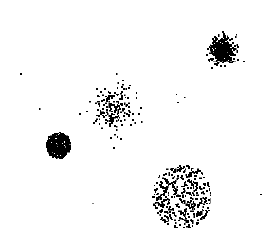
Outliers
Outliers are data objects with characteristics that are considerably different than most of the other data objects in the data set
Case 1: Outliers are noise that interferes with data analysis
Case 2: Outliers are the goal of our analysis
Credit card fraud
Intrusion detection
Causes?

Slide 18
Missing Values
Reasons for missing values
Information is not collected (e.g., people decline to give their age and weight)
Attributes may not be applicable to all cases (e.g., annual income is not applicable to children)
Handling missing values
Eliminate data objects or variables
Estimate missing values
Example: time series of temperature
Example: census results
Ignore the missing value during analysis

Slide 19
Duplicate Data
Data set may include data objects that are duplicates, or almost duplicates of one another
Major issue when merging data from heterogeneous sources
Examples:
Same person with multiple email addresses
Data cleaning
Process of dealing with duplicate data issues
When should duplicate data not be removed?

Slide 20
Summary
Ordered Data
Data Quality
Causes of Data Quality?
What is the problem with data Quality?

Slide 21
Lecture 5 Issues Related to Application in Data Quality
Vaibhav Chunekar
19/1/2022

Slide 22
Revision
Ordered Data
Data Quality:
Poor data quality negatively affects many data processing efforts
Causes of Data Quality:
Manual Entry
OCR errors
Lack of complete information
Ambiguous data
Duplicate data
Data transformation errors
What is the problem with data Quality:
Noise and outliers
Wrong data
Fake data
Missing values
Duplicate data

Slide 23
Agenda
Data Quality Issues
Trouble with Data quality issues to Businesses and Industries
General Issues to all industries and businesses
Timeliness
Relevance
Knowledge about data
Introduction to Data Processing

Slide 24
Data Quality Issues
Have any business processes/activities been impacted by the data issue?
If so, how many business processes/activities are impacted by the data issue?
What business applications have failed as a result of the data issue?
If so, how many business processes have failed?
How many individuals are affected?
How many systems are affected?
What types of systems are affected?

Slide 25
Data Quality Issues
• How many records are affected?
• How many times has this issue been reported? Within what time frame?
• How long has this been an issue?
Then, based on the list of individuals and systems affected, the data quality analyst can review business impacts within the context of both known and newly discovered issues, asking questions such as these:

Slide 26
Data Quality issues
• What are the potential business impacts?
• Is this an issue that has already been anticipated based on the data requirements analysis process?
• Has this issue introduced delays or halts in production information processing that must be performed within existing constraints?
• Has this issue introduced delays in the development or deployment of critical business systems

Slide 27
Data Quality
“Data of high quality if it suitable for intended use”-- Viewpoint
Useful both Industries and business
Statistical Field-Data Collect relevant to hypothesis.
Many issues are there to specific application. Will discuss General Issues-
Timeliness
Relevance
Knowledge about data

Slide 28
Timeliness
Consider the data from some ongoing phenomenon or process
Snapshot of phenomenon
Example-Purchasing Behavior of Customer / web browsing
Snapshot→ reality for Limited Time
Data—Out of Date→ Data Model /pattern is also out of date

Slide 29
Relevance
The available data must contain the information necessary for the application.
Example:
Predict Accident Rate of Driver-
Building Model
Information-age ,gender(Omitted then limited accuracy)
Challenges- Sampling Bias
Sample does not contains different types of object in proportion to their actual occurrence in the population.
Example-
survey data-limited people involve- erroneous result-broader application

Slide 30
Knowledge about data
Data set accompanied by Documentation
Quality aid or hinder analysis
Ex: documentation-redundant data information then strogly related
: Sale tax and purchase price
Missing Value—9999 Analysis faulty
Important characteristics of data quality
Precision of data
Data attributes
Scale of measurement
Origin of data

Slide 31
Data Transformation to make suitable for Mining
Data Processing
Aggregation
Sampling
Dimensionality Reduction
EDA Vs Classical Data Analysis

Slide 32
Summarized
Data Quality Issue broader perspectives
Data Quality General Issue-Timeliness,Relevance and Knowledge Data
Introduction to Transformation of data

Slide 33
Lecture 6 EDA Vs Classical Data Analysis
Vaibhav Chunekar
20/1/2022

Slide 34
Agenda
Recap Data Quality Issues
Data Transformation Techniques
EDA Vs Classical Data Analysis

Slide 35
Data Transformation in Data Mining
The data are transformed in ways that are ideal for mining the data. The data transformation involves steps that are:
Smoothing
Aggregation
Discretization
Attribute Construction
Generalization
Normalization

Slide 36
Smoothing
It is a process that is used to remove noise from the dataset using some algorithms It allows for highlighting important features present in the dataset. It helps in predicting the patterns. When collecting data, it can be manipulated to eliminate or reduce any variance or any other noise form.
The concept behind data smoothing is that it will be able to identify simple changes to help predict different trends and patterns. This serves as a help to analysts or traders who need to look at a lot of data which can often be difficult to digest for finding patterns that they wouldn’t see otherwise.

Slide 37
Aggregation
Data collection or aggregation is the method of storing and presenting data in a summary format. The data may be obtained from multiple data sources to integrate these data sources into a data analysis description. This is a crucial step since the accuracy of data analysis insights is highly dependent on the quantity and quality of the data used. Gathering accurate data of high quality and a large enough quantity is necessary to produce relevant results.
The collection of data is useful for everything from decisions concerning financing or business strategy of the product, pricing, operations, and marketing strategies.
For example, Sales, data may be aggregated to compute monthly& annual total amounts.

Slide 38
Discretization
It is a process of transforming continuous data into set of small intervals. Most Data Mining activities in the real world require continuous attributes. Yet many of the existing data mining frameworks are unable to handle these attributes.
Also, even if a data mining task can manage a continuous attribute, it can significantly improve its efficiency by replacing a constant quality attribute with its discrete values.
For example, (1-10, 11-20) (age:- young, middle age, senior).

Slide 39
Attribute Construction
Where new attributes are created & applied to assist the mining process from the given set of attributes. This simplifies the original data & makes the mining more efficient

Slide 40
Generalization
It converts low-level data attributes to high-level data attributes using concept hierarchy. For Example Age initially in Numerical form (22, 25) is converted into categorical value (young, old).
For example, Categorical attributes, such as house addresses, may be generalized to higher-level definitions, such as town or country.

Slide 41
Normalization
Data normalization involves converting all data variable into a given range.
Techniques that are used for normalization are:
Min Max Normalization
Z Score Normalization
Decimal Scaling

Slide 42

Min-Max Normalization:
This transforms the original data linearly.
Suppose that min_A is the minima and max_A is the maxima of an attribute, P
We Have the Formula:
Where v is the value you want to plot in the new range.
v’ is the new value you get after normalizing the old value.

Slide 43

Solved example:
Suppose the minimum and maximum value for an attribute profit(P) are Rs. 10, 000 and Rs. 100,000. We want to plot the profit in the range [0, 1]. Using min-max normalization the value of Rs. 20, 000 for attribute profit can be plotted to:
And hence, we get the value of v’ as 0.11

Slide 44

Z-Score Normalization:
In z-score normalization (or zero-mean normalization) the values of an attribute (A), are normalized based on the mean of A and its standard deviation
A value, v, of attribute A is normalized to v’ by computing

Slide 45

example:
Let mean of an attribute P = 60, 000, Standard Deviation = 10, 000, for the attribute P. Using z-score normalization, a value of 85000 for P can be transformed to:
And hence we get the value of v’ to be 2.5

Slide 46
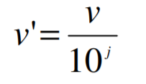
Decimal Scaling:
It normalizes the values of an attribute by changing the position of their decimal points
The number of points by which the decimal point is moved can be determined by the absolute maximum value of attribute A.
A value, v, of attribute A is normalized to v’ by computing
where j is the smallest integer such that Max(|v’|) < 1

Slide 47
Example
Suppose: Values of an attribute P varies from -99 to 99.
The maximum absolute value of P is 99.
For normalizing the values we divide the numbers by 100 (i.e., j = 2) or (number of integers in the largest number) so that values come out to be as 0.98, 0.97 and so on

Slide 48
What is EDA?
Exploratory Data Analysis (EDA) is an approach/philosophy for data analysis that employs a variety of techniques (mostly graphical) to
maximize insight into a data set;
uncover underlying structure;
extract important variables;
detect outliers and anomalies;
test underlying assumptions;
develop parsimonious models; and
determine optimal factor settings.

Slide 49
Focus of EDA?
The EDA approach is precisely that--an approach--not a set of techniques, but an attitude/philosophy about how a data analysis should be carried out.

Slide 50
Philosophy of EDA
EDA is not identical to statistical graphics although the two terms are used almost interchangeably.
Statistical graphics is a collection of techniques--all graphically based and all focusing on one data characterization aspect.
EDA encompasses a larger venue; EDA is an approach to data analysis that postpones the usual assumptions about what kind of model the data follow with the more direct approach of allowing the data itself to reveal its underlying structure and model.
EDA is not a mere collection of techniques; EDA is a philosophy as to how we dissect a data set; what we look for; how we look; and how we interpret.
It is true that EDA heavily uses the collection of techniques that we call "statistical graphics", but it is not identical to statistical graphics per se.

Slide 51
History of EDA
The seminal work in EDA is Exploratory Data Analysis, Tukey, (1977). Over the years it has benefitted from other noteworthy publications such as Data Analysis and Regression, Mosteller and Tukey (1977), Interactive Data Analysis, Hoaglin (1977), The ABC's of EDA, Velleman and Hoaglin (1981) and has gained a large following as "the" way to analyze a data set.

Slide 52
Techniques EDA
Most EDA techniques are graphical in nature with a few quantitative techniques.
The reason for the heavy reliance on graphics is that by its very nature the main role of EDA is to open-mindedly explore, and graphics gives the analysts unparalleled power to do so, enticing the data to reveal its structural secrets, and being always ready to gain some new, often unsuspected, insight into the data.
In combination with the natural pattern-recognition capabilities that we all possess, graphics provides, of course, unparalleled power to carry this out.

Slide 53
Special Graphical Techniques in EDA
The particular graphical techniques employed in EDA are often quite simple, consisting of various techniques of:
Plotting the raw data (such as data traces, histograms, bihistograms, probability plots, lag plots, block plots, and Youden plots.
Plotting simple statistics such as mean plots, standard deviation plots, box plots, and main effects plots of the raw data.
Positioning such plots so as to maximize our natural pattern-recognition abilities, such as using multiple plots per page.

Slide 54
EDA Vs classical Data Analysis
These two approaches are similar in that they all start with a general science/engineering problem and all yield science/engineering conclusions. The difference is the sequence and focus of the intermediate steps.
classical Data Analysis | EDA
For classical analysis, the sequence is Problem => Data => Model => Analysis => Conclusions | For EDA, the sequence is Problem => Data => Analysis => Model => Conclusions

Slide 55
EDA Vs classical Data Analysis
For classical analysis, the data collection is followed by the imposition of a model (normality, linearity, etc.) and the analysis, estimation, and testing that follows are focused on the parameters of that model.
For EDA, the data collection is not followed by a model imposition; rather it is followed immediately by analysis with a goal of inferring what model would be appropriate.

Slide 56
Model
Classical Data Analysis | EDA
The classical approach imposes models (both deterministic and probabilistic) on the data. Deterministic models include, for example, regression models and analysis of variance (ANOVA) models. The most common probabilistic model assumes that the errors about the deterministic model are normally distributed--this assumption affects the validity of the ANOVA F tests. | The Exploratory Data Analysis approach does not impose deterministic or probabilistic models on the data. On the contrary, the EDA approach allows the data to suggest admissible models that best fit the data.

Slide 57
Focus
Classical Data Analysis | EDA
The two approaches differ substantially in focus. For classical analysis, the focus is on the model--estimating parameters of the model and generating predicted values from the model | For exploratory data analysis, the focus is on the data--its structure, outliers, and models suggested by the data

Slide 58
Techniques used
Classical Data Analysis | EDA
Classical techniques are generally quantitative in nature. They include ANOVA, t tests, chi-squared tests, and F tests. | EDA techniques are generally graphical. They include scatter plots, character plots, box plots, histograms, bihistograms, probability plots, residual plots, and mean plots

Slide 59
Rigor
Classical Data Analysis | EDA
Classical techniques serve as the probabilistic foundation of science and engineering; the most important characteristic of classical techniques is that they are rigorous, formal, and "objective". | EDA techniques do not share in that rigor or formality. EDA techniques make up for that lack of rigor by being very suggestive, indicative, and insightful about what the appropriate model should be. EDA techniques are subjective and depend on interpretation which may differ from analyst to analyst, although experienced analysts commonly arrive at identical conclusions.

Slide 60
Data Treatment
Classical Data Analysis | EDA
Classical estimation techniques have the characteristic of taking all of the data and mapping the data into a few numbers ("estimates"). This is both a virtue and a vice. The virtue is that these few numbers focus on important characteristics (location, variation, etc.) of the population. The vice is that concentrating on these few characteristics can filter out other characteristics (skewness, tail length, autocorrelation, etc.) of the same population. In this sense there is a loss of information due to this "filtering" process. | The EDA approach, on the other hand, often makes use of (and shows) all of the available data. In this sense there is no corresponding loss of information.

Slide 61
Data Treatment
Classical Data Analysis | EDA
Classical estimation techniques have the characteristic of taking all of the data and mapping the data into a few numbers ("estimates"). This is both a virtue and a vice. The virtue is that these few numbers focus on important characteristics (location, variation, etc.) of the population. The vice is that concentrating on these few characteristics can filter out other characteristics (skewness, tail length, autocorrelation, etc.) of the same population. In this sense there is a loss of information due to this "filtering" process. . | The EDA approach, on the other hand, often makes use of (and shows) all of the available data. In this sense there is no corresponding loss of information.

Slide 62
Assumptions
Classical Data Analysis | EDA
Classical estimation techniques have the characteristic of taking all of the data and mapping the data into a few numbers ("estimates"). This is both a virtue and a vice. The virtue is that these few numbers focus on important characteristics (location, variation, etc.) of the population. The vice is that concentrating on these few characteristics can filter out other characteristics (skewness, tail length, autocorrelation, etc.) of the same population. In this sense there is a loss of information due to this "filtering" process. | Many EDA techniques make little or no assumptions--they present and show the data--all of the data--as is, with fewer encumbering assumptions

Slide 63
Summary
Data Transformation Techniques
EDA vs Classical Data Analysis

Slide 64
Thanks!!!!!

